Slide 1
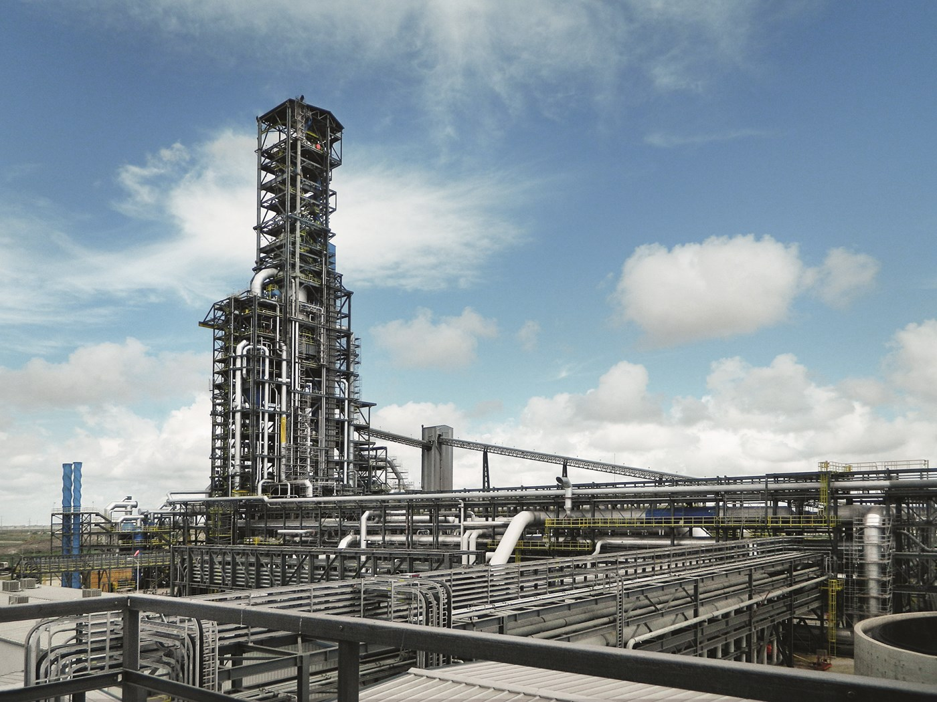
ArcelorMittal Project

Slide 2

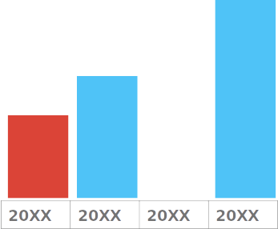
Project Goals
Predicting width constrictions during hot rolling

Slide 3


Using Python advanced,several libraries and Machine Learning tools to analyze the data, visualize, pre-process and create models to predict width constriction of Coils

Slide 4



Mousumi Sen
Junior Data Scientist

Slide 5
Project Pipeline
Data Labeling
Data Cleaning
Data Splitting
Down Sampling
Data Standardization

